Slide 1
While we’re getting started, please reflect on a time when you were an immigrant or a visitor to somewhere unfamiliar. (For some of you, this may have been coming to the US as an immigrant.)
What was challenging for you?
What was valuable about the experience?
Photo: Courtesy of John Abramson

Slide 2
Co-Sponsor Team Training Parts 1 & 2
Co-Sponsorship Overview
Refugee 101
ACC’s Programs & Services
Afghan Cultural Cues
Partnering with Refugees: Volunteer Frameworks
Photo: Courtesy of John Abramson

Slide 3
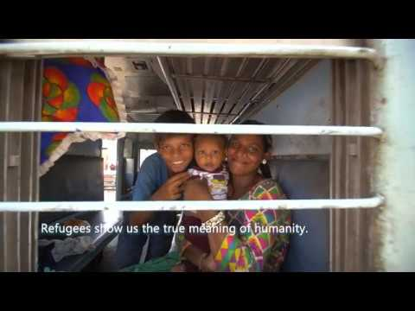
What do we do?
Notes:
This video does a great job of succinctly capturing the many ways that we work with refugees.
I’m going to play the first few seconds or so and then pause it to check in to make sure that you are able to both view and hear it.

Slide 4
Photo Courtesy of Church World Service
Notes:
The work of co-sponsorship is to come alongside us to partner with a refugee family and offer support and assistance as they learn their new home, become acquainted with culture, language, and their physical surroundings, and start on their path to self-sufficiency.
At its heart, co-sponsorship creates opportunities for communities to play a key role in supporting refugees and other forcibly displaced individuals as they settle into their homes.
In co-sponsorship, refugees are paired with groups (e.g. faith communities, businesses, civil society organizations, clubs) who provide clearly defined financial and/or in-kind contributions and volunteer services to support their welcome and integration over a set period of time.
What are the benefits of community sponsorship?
Community sponsorship facilitates refugee integration by connecting refugees more directly to community members and strengthens local community support for refugees and immigrants. Through sponsorship, groups engage with and reconnect to their local communities, bringing about stronger, more cohesive societies.
Community sponsorship is a significant commitment, but it also has proven to be an extremely rewarding one that often builds powerful bonds between sponsor groups and the refugees they welcome. The current moment presents a critical opportunity to reimagine resettlement and lay the groundwork for a future, reinvigorated system built on community participation.
In support of this community-driven effort, a coalition of funders including the Open Society Foundations, The Shapiro Foundation, and philanthropists G. Barrie Landry and Laurie T. Franz, came together about a year ago to establish a new fund to help organizations across the United States develop, implement, and enhance community sponsorship programs.
The first private fund to expand community sponsorship in the United States
ACC applied for and was one of 8 organizations across the country to receive a Community Sponsorship Catalyst Fund grant. It is a 2 year grant. We’ve used the past few months to research existing program sponsorship models, interview our refugee community members, and conduct focus groups with our volunteers and staff to in order to determine the best path forward for a sponsorship program at ACC. Our goal is to pilot our new program with one or two community groups this year, and increase that number up to approximately 5 groups in 2022.
You are the first group to receive this presentation! We’re still working out the details and the kinks!

Slide 5
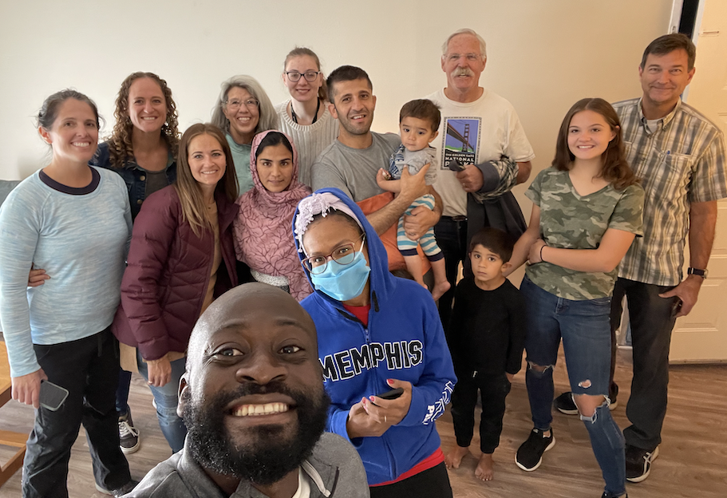
Social Bridging
Photo Courtesy of Church World Service
Notes:
Friendship with those outside the person’s own ethnic community was greatest indicator and predictor of successful integration (RISE Survey)
*Photo not to be shared publicly/externally
Refugee Integration Survey & Evaluation (RISE) project. The purpose of the project was to assess refugee integration into U.S. society in the early years of resettlement by focusing on a single cohort of refugees during the first 3‐4 years of resettlement. Quality Evaluation Designs’ (QED) RISE research team developed and piloted a survey instrument that effectively assesses refugee integration, as well as conducted interviews and focus groups to understand the range of refugees’ experiences during integration. The RISE survey was first administered to nearly all adult refugees who arrived in Denver from Bhutan, Burma, Somalia, and Iraq during 2011‐12. Fiscal Year 2014‐15 was the fourth consecutive year of data collection and fifth and final year of the grant. In that year the RISE survey was completed by 327 refugees of the original 467 who took it at Baseline. This reflects 70% retention from Baseline.

Slide 6
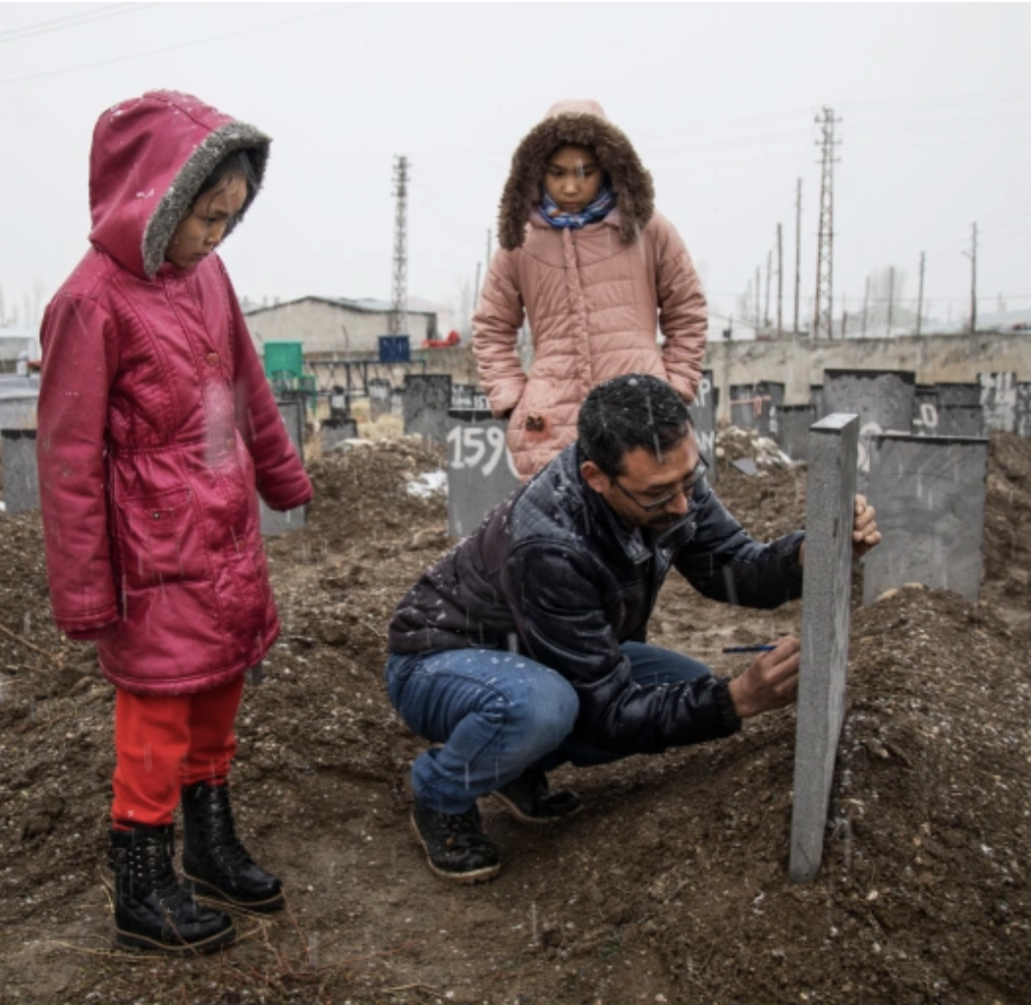
Who is a Refugee?
A person
forced to flee
their home country to escape persecution, war, or violence
ACC also works with
Asylees
Sources: 1951 Refugee Convention
UNHCR
Notes:
The 1951 Refugee Convention defines a refugee as someone who is unable or unwilling to return to their country of origin owing to a well-founded fear of being persecuted for 5 reasons. The law identifies 5 categories of persecution that qualify someone as a refugee:
Race.
Religious persecution.
Membership of a Particular Social Group
Political Opinion
Nationality/Ethnic group -
About 65,000 refugees have been resettled in CO since 1980
CLICK. Asylees are are people who are already inside the country or at a border when they present their claim to asylum. The U.S. government then processes the claim according to these same criteria. At ACC, we can only serve people who have been granted asylum, not those whose cases are pending.
This photo is of Hamdi Mohseni– an ethnic Hazara from Jaghori, in Afghanistan’s central Ghazni province. Afghanistan is a tribal country with a number of different ethnic groups.
The Hazaras are said to be of Mongolian and Central Asian descent, and the descendants of Mongolian leader Genghis Khan, who invaded Afghanistan in the 13th Century. They are mostly based in the mountainous area of central Afghanistan known as 'Hazaristan', or the land of the Hazaras. Around 10 per cent Muslims in Sunni-majority Afghanistan are Shiite and almost all of them are Hazaras. The Taliban as well as the Islamic State are Sunni groups.
Hazaras have been persecuted and repressed by the majority Sunni population in Afghanistan even as far back as in the reign of Pashtun leader Amir Abdul Rahman in the 1880s, when Sunni leaders had declared jihad on all Shias of the country.
After the Taliban took over Afghanistan in 1996, ethnic minority groups, such as the Hazaras, and women bore the brunt of the Taliban torture.
Even though the Constitution of Afghanistan gave equal rights to Hazaras in 2004 and former president Hamid Karzai had included Hazaras in his cabinet, the minority group continues to face discrimination and is placed at the bottom of the socio-economic ladder in the country.
The Taliban’s hatred for the Hazaras is primarily due to their different sect and distinct ethnic origins, and they thus consider them to be ‘infidels’. In a report by Human Rights Watch, during the Taliban’s search operations in Mazar, it ordered some residents to prove that they were not Shia by reciting Sunni prayers.
In 2018 as the the Taliban was expanding it’s control over Afghanistan, they launched an offensive into the Ghazni province where Hamdi lived.
He needed to take his daughter Faisa, who was 12, to a nearby city to get medical treatment for her seizures. But with each trip to Ghazni city, the former-farmer-turned-welder says, the Taliban fighters running a checkpoint on the road grew more suspicious of him, turning him back around.
“I told them we were poor, and we are only going to get medication for my child, but they detained me. They took out all my fingernails with pliers,” he says. They threatened to kill him if they saw him again.
Relocating to another part of Afghanistan offered no guarantee of work or safety or the promise of medical treatment for Faisa, so the family decided to leave the country and try to reach Europe. They paid smugglers to cross into Iran from Afghanistan’s Herat province, then spent another month and a half being passed from one smuggler to the next, westward through Iran.
A half-hour drive west of the Iranian city of Urmia, Mohseni says, he and hundreds of other Afghans were brought to the foothills of the mountains straddling the Turkish border. He was told either to pay to hire a horse or to leave his children and wife behind because they would slow the group down. He turned over the rest of his money for the horse to carry his wife and five of their children, while he carried one daughter on his back.
At the top of the ridge, the smuggler left them. “On this side of the mountain was Iran, and on the other Turkey … he showed me the Turkish police and Iranian police,” Mohseni says. “They told me how to pass to not be arrested by either.”
In Turkey, Mohseni and the others spent weeks being moved around by more smugglers, driven in the dead of night from one place to the next as they moved west. Their goal was to reach the capital, Ankara, where they would register for temporary protection with the UN.
Finally, in early 2019, one night in the city of Van – “when the smuggler figured he couldn’t get any more money out of us,” Mohseni says – they were put in a minivan and told they would be taken west to the city of Tatvan, and then on to Ankara.
The only seat was for the driver, everything else was taken out to make room for the people the smugglers would pack inside, nearly 60 of them, Mohseni says, by the time they set off for what they were told was a half-hour journey. But they kept driving late into the night, as they took unpaved roads through the mountains to evade police.
Mohseni was holding four-year-old Zahra in his lap, when, somewhere near the town of Bitlis, the minivan flipped off the road.
“My daughter’s stomach was torn apart… her stomach was out of her body,” Mohseni says. “I was so focused on her stomach I did not notice her head injury.”
Instead of calling an ambulance, the driver called other smugglers, who dropped the family off outside a hospital where Zahra was admitted for treatment. Mohseni and his family members were arrested by Turkish police. Each day they were allowed two hours out to visit the hospital, where Zahra had slipped into a coma.
One evening, 10 days after the accident, as Mohseni was being brought back to prison, he was told Zahra had died.
Every Sunday, Hamdi Mohseni, his wife Serda, and their five remaining children, walk the 15km from their apartment to the paupers’ cemetery where their daughter Zahra is buried. Mohseni brings a ballpoint pen with him to trace the letters of her name in the concrete tombstone, to make sure it does not disappear among the hundreds of knee-high concrete slabs in this cemetery in Van, in the east of Turkey near the Iranian border.
Most of the gravestones have no names at all. One might note where the body was found; another might have a number signifying where in a year’s sequence of burials that one took place; another might include the name of a place – the authorities’ best guess at where the deceased came from.
Mohseni, who speaks softly with a distant look in his eyes, says in the last two years he has seen no other visitors here, except for the gravediggers who show up to inter the dead. According to Turkish officials, the vast majority of graves have been filled with Afghans, who for four decades have been fleeing the chaos wrought in Afghanistan by one of the world’s longest ongoing conflicts.
https://www.aljazeera.com/features/2020/11/25/afghan-refugees-struggle-to-reach-europe-to-start-new-life

Slide 7
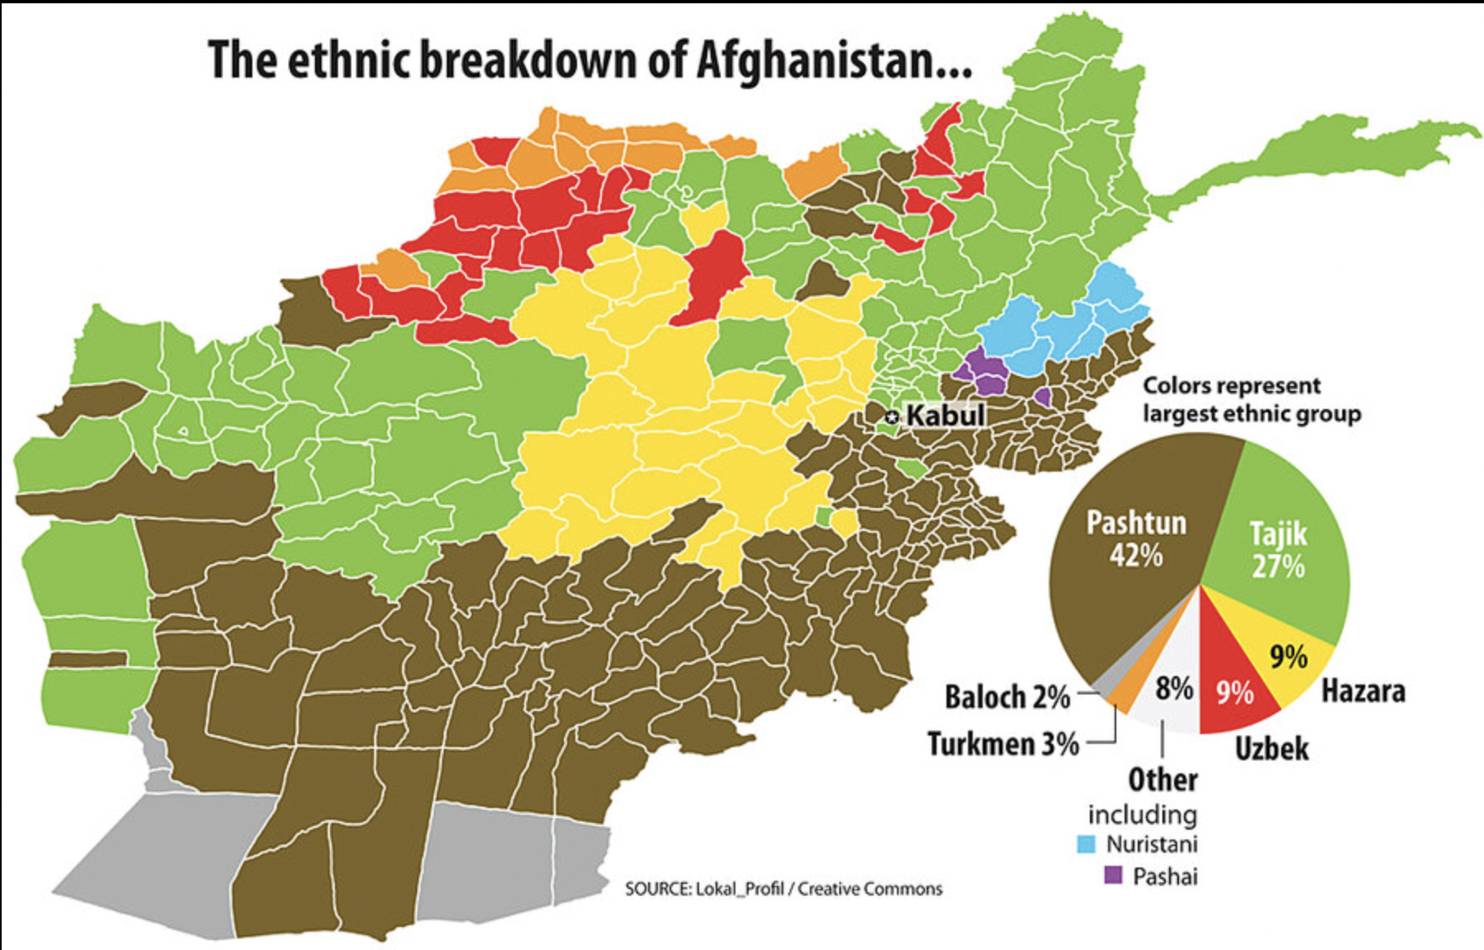
Sources: 1951 Refugee Convention
UNHCR

Slide 8
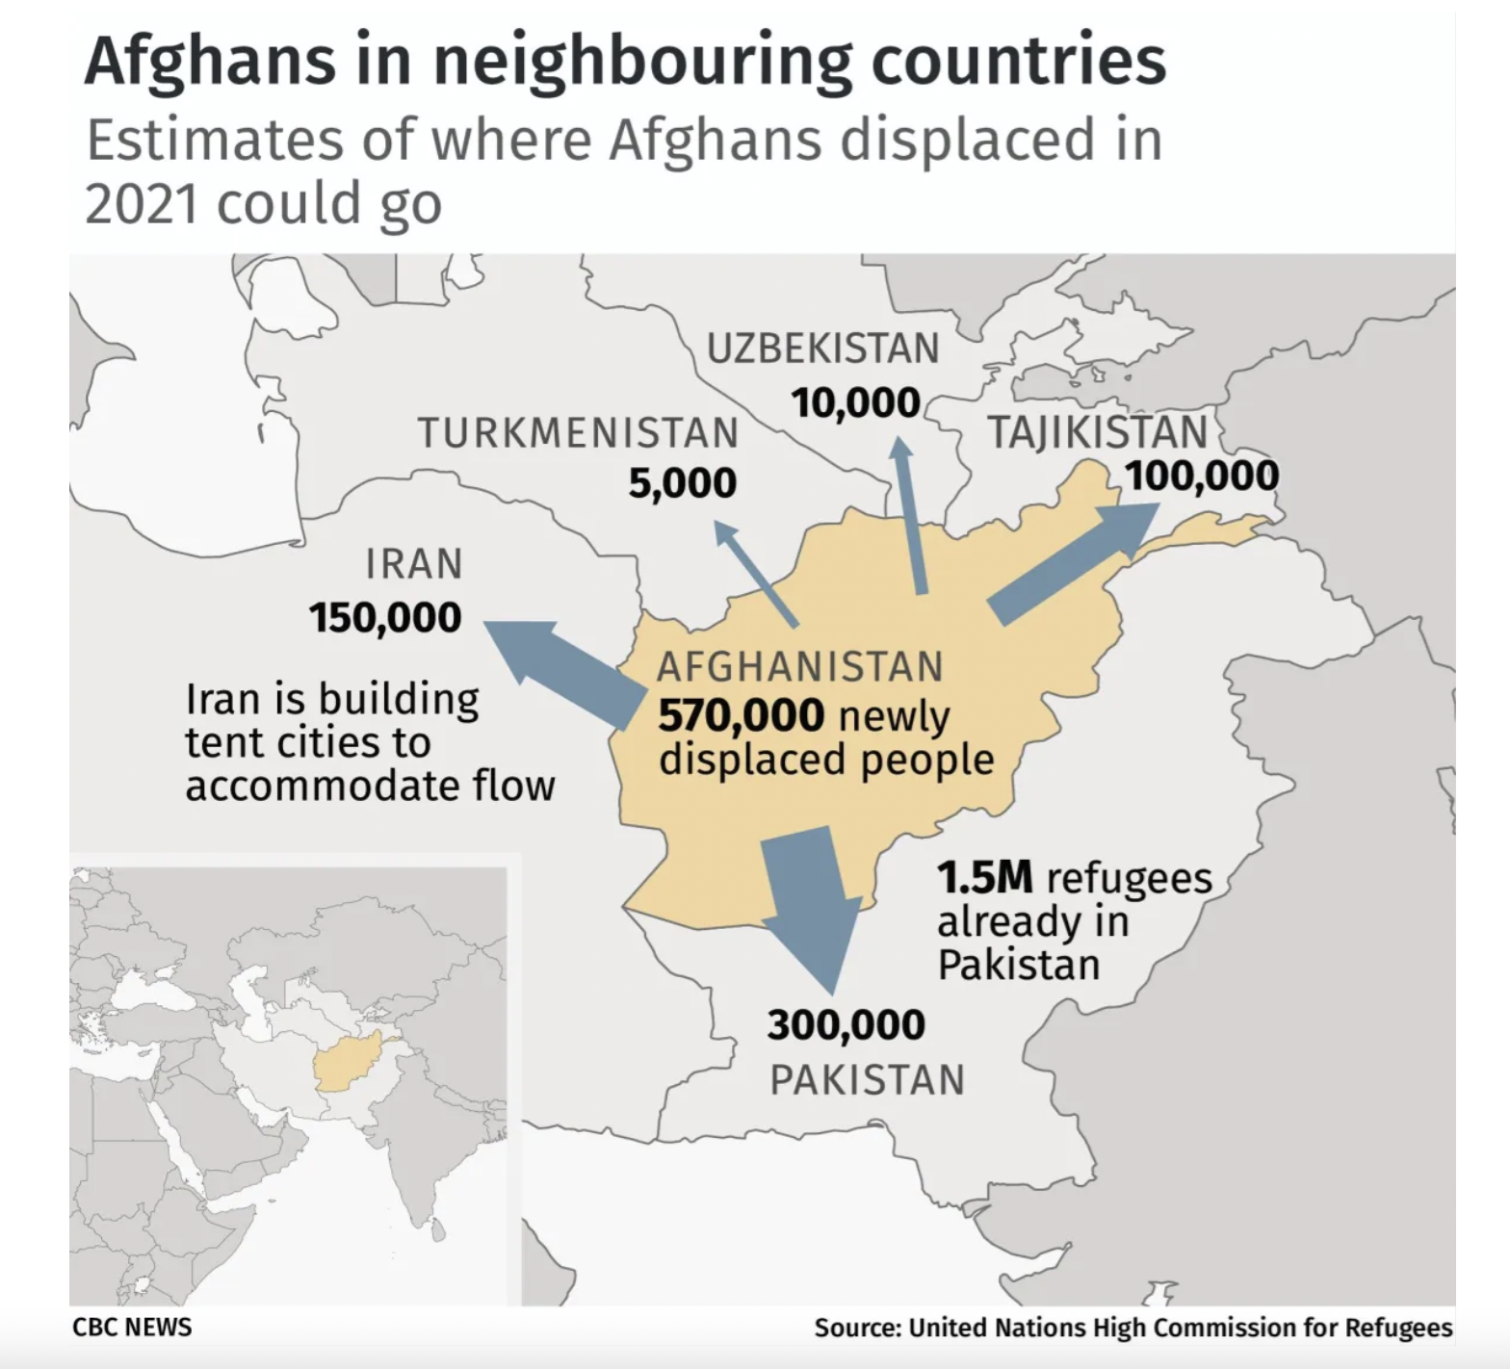
Afghanistan
Notes:
Afghans have suffered more than 40 years of conflict, natural disasters, chronic poverty, food insecurity and most recently the COVID-19 pandemic. Violence in Afghanistan is worsening in intensity and spreading in reach – causing even more human suffering and displacement. Their resilience and the resilience of their host communities is being stretched to the absolute limit.
After more than four decades of displacement, Afghan refugees constitute one of the largest protracted refugee situations in the world. There are nearly 6 million Afghans who have been forcibly displaced from their homes. Of those, 3.5 million are displaced within Afghanistan; 2.6 million are Afghan refugees living in other countries.
Pakistan is currently hosting over 1.5 million Afghan refugees.
Pakistan 1.5 million
Iran 780,000
Germany 180,000
Turkey 130,000
The United Nations refugee agency (UNHCR) has projected that a half million Afghans may seek to leave by the end of 2021. Many Afghans fear persecution or reprisals under Taliban rule and hope to seek asylum or other pathways to safely migrate abroad. Some Afghans already outside the country are looking for temporary protection or permanent legal status abroad.
The Taliban takeover of Afghanistan in August 2021 caused tens of thousands of Afghans to flee, often by taking desperate measures. Many others who want to flee are still seeking secure safe passage out of the country. Countless Afghans remain at risk of being targeted for their past work or association with coalition forces, Afghanistan’s former government, international development programs, media, civil society, and other organizations promoting human rights. Women and girls and their families, especially those who fear that they can no longer work or study, are also motivated to flee the country.
There are already 2.6 million Afghans refugees in the world—a figure that's sure to rise significantly as the U.S. and other allies race to complete an evacuation of the country by the looming August 31 deadline.
Afghans have faced 40 years of war in their country, and many have been forced to flee, sometimes repeatedly, during those decades. At least 2.6 million Afghans were already living abroad as registered refugees, with the largest numbers in neighboring Pakistan, Iran, and Turkey. More than 3 million people had been internally displaced in Afghanistan by the end of 2020, and the UN refugee agency estimated that over 550,000 more Afghans were displaced within the country from the beginning of the year until August 10, including about 240,000 displaced since the withdrawal of coalition military forces began in May.
Over the years, most Afghans who have fled their country have been hosted by neighboring Iran and Pakistan. Others have made their way to Turkey, Germany, and India. At some points in the past, Afghans in Iran and Pakistan were recognized as prima facie refugees. But, due to inconsistent policy towards recognizing their status, most displaced Afghans in both countries today are not recognized as refugees.
As of July, Iran hosted 800,000 registered refugees and up to 3 million other displaced Afghans. Refugees and asylum seekers from Afghanistan have also faced abuses in Iran, including being prohibited from living in “no-go areas,” areas in most provinces off-limits to all non-citizens; being denied access to education; and being detained and deported without due process. Between 2019 and early 2021, Iran pushed almost 1.5 million Afghans back to Afghanistan, many involuntarily.
Pakistan has 1.4 million registered Afghan refugees and up to 2 million other displaced Afghans. For years, Afghans living in Pakistan have faced police abuse and forced returns.

Slide 9
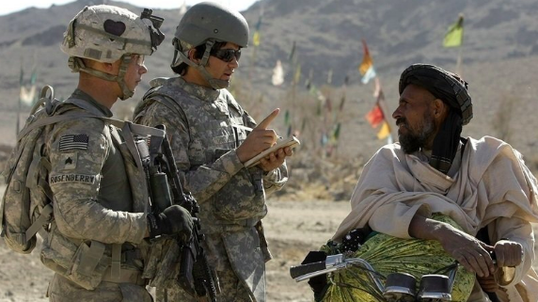
Other ORR Eligible Populations
ORR = Office of Refugee Resettlement
Special Immigrant
Visa Holders (SIVs)
Humanitarian Parolees
Sources: 1951 Refugee Convention
UNHCR
Notes:
Afghans who hold SIV status have worked for the U.S. government or contractors in Afghanistan for at least a year. They went through a 14-step SIV application process, which can take several years to complete. SIV status also covers applicants' immediate relatives.
Before traveling to the U.S., SIV holders will receive documents to present to Customs and Border Protection (CBP) once they arrive in the United States. After that, permanent residency cards, also known as green cards, are mailed to the addresses they provided.
Afghans who were not SIV applicants at the time of their evacuation qualify for “humanitarian parole.” Under the Immigration and Nationality Act, certain individuals can enter and stay in the U.S. without visas temporarily because of “urgent humanitarian reasons,” but they are ineligible for permanent residency.
According to DHS, Afghan nationals who are paroled into the country will have conditions placed on their statuses, including medical screening, vaccination requirements and other reporting requirements to U.S. immigration authorities. If they fail to follow the conditions, the government can deny their applications for work authorization and “potentially” terminate their parole and deport them.
Parolees can apply for asylum in the United States, the same avenue open to some migrants arriving at the U.S.-Mexico border. But refugee advocates call it a “very bureaucratic and inefficient way” to help resettle Afghans because of the long timetable for completing the process.
Going through “that whole system doesn't seem like the best way to address a population [of evacuees] that, all of whom, will likely qualify for asylum,” said Melanie Nezer, a spokesperson for the immigrant advocacy group HIAS.
Afghan nationals may claim asylum immediately, or up to one year after their arrival in the United States. After filing, each applicant will then meet with an asylum officer who approves or rejects the claim. If an asylum case is not approved, it is sent to an immigration judge.
Humanitarian parole is used to bring someone who is otherwise inadmissible into the United States for a temporary period of time due to an emergency. You may apply for humanitarian parole if you have a compelling emergency and there is an urgent humanitarian reason or significant public benefit to allowing you to temporarily enter the United States.
The Form I-94 provides proof of the beneficiary’s entry as a parolee and the date by which the beneficiary must depart the United States. Parole ends on the date the parole period expires, when the beneficiary departs the United States, or when the beneficiary acquires an immigration status, whichever occurs first.
Parole is not a legal immigration status and does not provide a path to legal immigration status. The beneficiary must take additional steps to ensure they remain legally present in the United States after their authorized period of parole has ended. Failure to maintain lawful presence throughout the parolee’s entire stay in the U.S. can have serious immigration consequences.

Slide 10
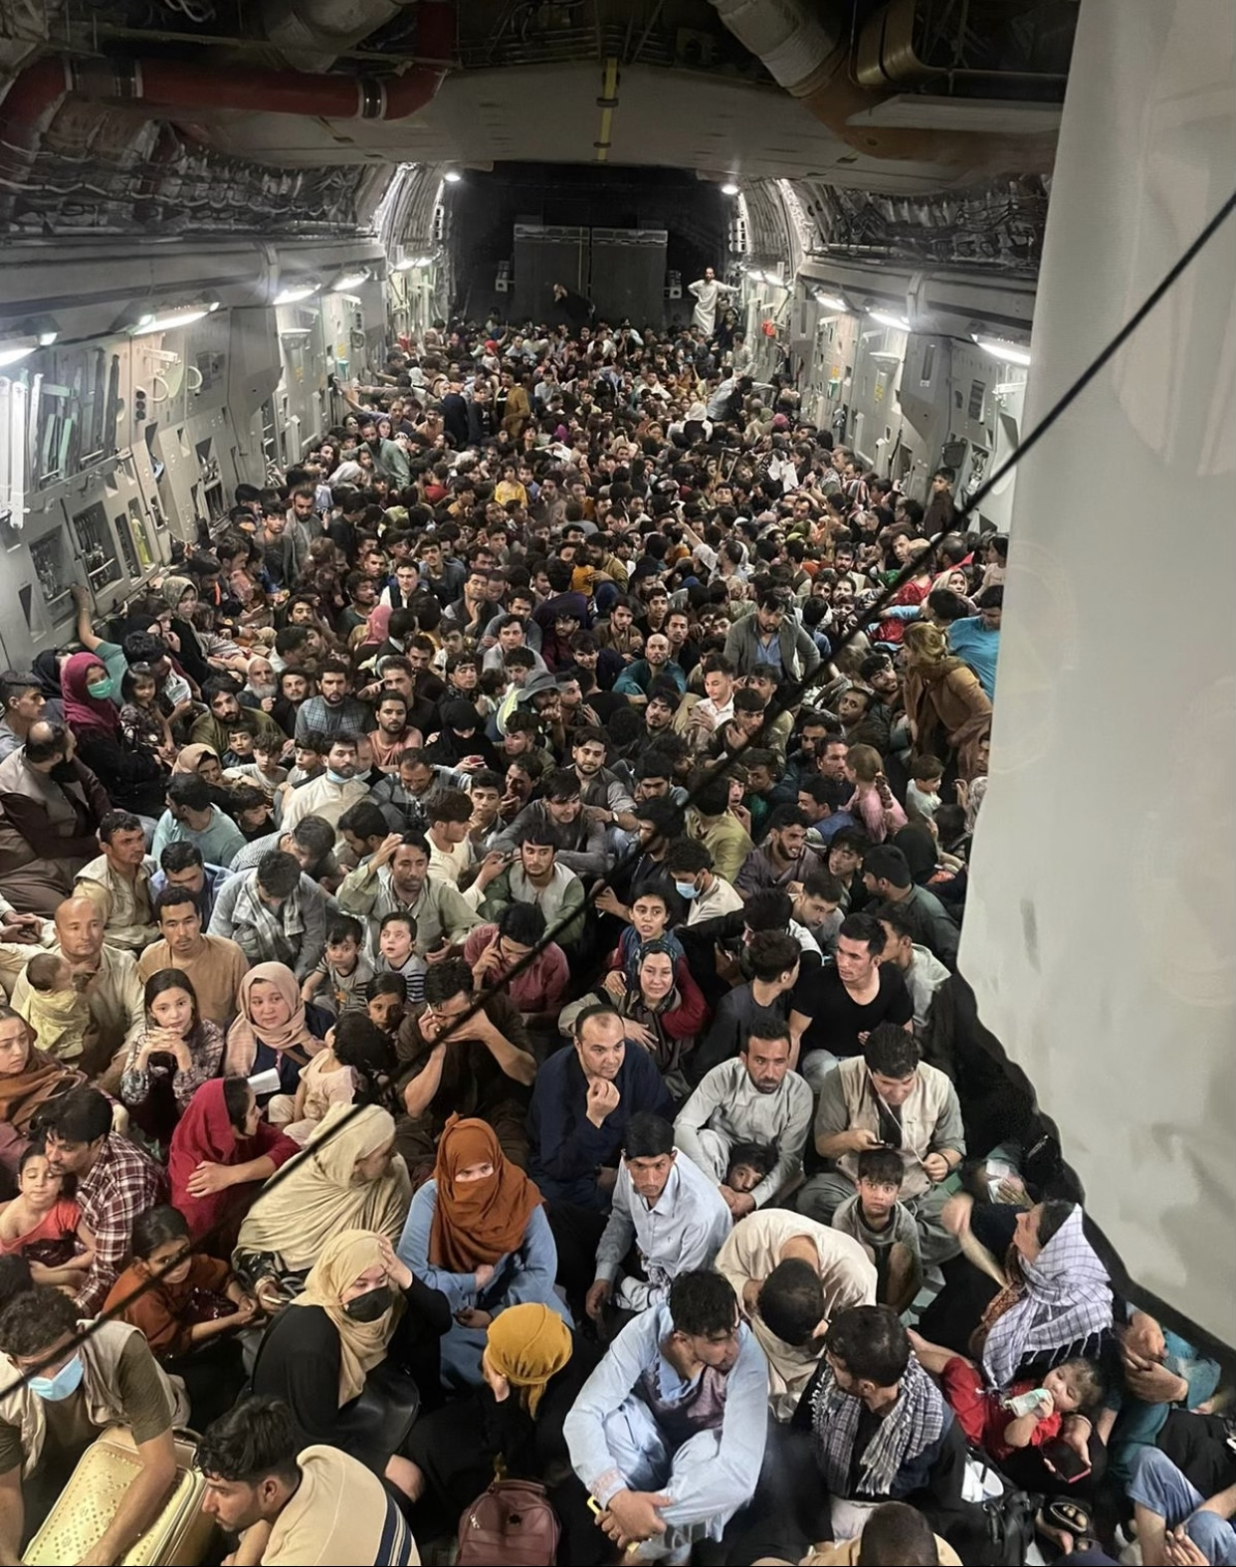
Afghan Evacuees
Sources: 1951 Refugee Convention
UNHCR
Notes:
The full uncropped photo from the inside of a U.S. Air Force C-17 flown from Kabul to Qatar on Aug. 15.
Largest evaculation airlift in US military history
In the days following the Taliban takeover in August, a US-led multinational airlift helped many international passport holders and Afghans to flee on hundreds of hastily coordinated evacuation flights from Kabul’s Hamid Karzai International Airport. US Pentagon officials said that the US-coordinated airlift evacuated nearly 125,000 people. Evacuees included many international staff of embassies and nongovernmental organizations, as well as others in the country holding foreign passports. But many thousands of Afghans who sought to flee, many of whom fear for their lives under Taliban rule, were not evacuated. Several hundred foreign passport holders are also believed to remain in the country.
The US-led airlift out of Kabul’s airport relocated those evacuated from Afghanistan to “processing stations” in other locations, including Albania, Kosovo, North Macedonia, Colombia, Ecuador, Cambodia, and Uganda. In some cases, evacuees were taken to US or joint military bases in Qatar, Germany, Spain, Kuwait, and Italy for expedited processing. Spain has been serving as the processing hub for newly arrived Afghans evacuated by the European Union. The US government uses such sites to hold Afghans while it completes their paperwork for resettlement or visa applications, including background checks and security screening. It is unclear how long Afghans may remain in these third countries before being transferred to the countries willing to resettle them permanently.
Approximately 300 Department of Homeland Security employees from Customs and Border Protection (CBP), Immigration and Customs Enforcement, the Transportation Security Administration and the Coast Guard have been dispatched overseas to conduct biometric and biographic screenings. Afghans cleared to come to the United States are vetted again upon arrival. Some have been sent back to foreign staging locations after being flagged for security concerns.
Tens of thousands of other Afghans are being housed in temporary facilities in third countries while their applications are being processed.
The Pentagon has said all evacuees are tested for COVID-19 upon arriving at the Dulles International Airport in Washington.
Refugees in third countries
In early August, the State Department announced the new P-2 Direct Access Program for Afghans who worked for the U.S. government, U.S.-based nongovernmental organizations or American news organizations.
The program provides a straightforward path to the refugee resettlement process but the refugees must, on their own, first reach a third country where they can contact the State Department to begin the resettlement process.
According to DHS, the State Department is managing referrals to the refugee program, but there is no direct contact with the U.S. government prior to an applicant's departure from Afghanistan.
Approved applicants will then receive travel documents and resettle in the United States.
Under U.S. immigration law, refugees may apply for green cards to become permanent residents after one year in the United States. After five years of permanent residency, they can apply for U.S. citizenship.
And an unknown number of potential migrants remain in Afghanistan, where many are still trying to complete the logistical and bureaucratic steps that would let them leave.
Pentagon officials said Wednesday that the U.S.-led airlift evacuated nearly 125,000 Afghans overall, but the Biden administration has not said how many it expects to resettle in the United States.
Gen. Mark A. Milley, chairman of the Joint Chiefs of Staff, told reporters Wednesday that approximately 43,000 Afghan evacuees are waiting at transit sites in Europe and the Middle East.
Humanitarian parole is used to bring someone who is otherwise inadmissible into the United States for a temporary period of time due to an emergency. You may apply for humanitarian parole if you have a compelling emergency and there is an urgent humanitarian reason or significant public benefit to allowing you to temporarily enter the United States.
The Form I-94 provides proof of the beneficiary’s entry as a parolee and the date by which the beneficiary must depart the United States. Parole ends on the date the parole period expires, when the beneficiary departs the United States, or when the beneficiary acquires an immigration status, whichever occurs first.
Parole is not a legal immigration status and does not provide a path to legal immigration status. The beneficiary must take additional steps to ensure they remain legally present in the United States after their authorized period of parole has ended. Failure to maintain lawful presence throughout the parolee’s entire stay in the U.S. can have serious immigration consequences.

Slide 11
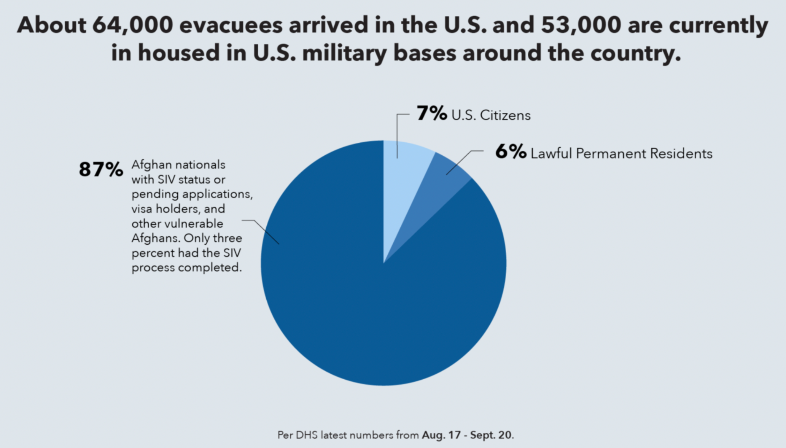
Afghan Evacuees
Sources: 1951 Refugee Convention
UNHCR
Notes:
Of the estimated 125,000 Afghans evacuated, 64,000 are already in the United States. Their first stop is at U.S. military bases, where their relocation paperwork is being processed while they are given access to medical screening and vaccinations.
Tens of thousands of other Afghans are being housed in temporary facilities in third countries while their applications are being processed.
The Pentagon has said all evacuees are tested for COVID-19 upon arriving at the Dulles International Airport in Washington.
Refugees in third countries
In early August, the State Department announced the new P-2 Direct Access Program for Afghans who worked for the U.S. government, U.S.-based nongovernmental organizations or American news organizations.
The program provides a straightforward path to the refugee resettlement process but the refugees must, on their own, first reach a third country where they can contact the State Department to begin the resettlement process.
According to DHS, the State Department is managing referrals to the refugee program, but there is no direct contact with the U.S. government prior to an applicant's departure from Afghanistan.
Approved applicants will then receive travel documents and resettle in the United States.
Under U.S. immigration law, refugees may apply for green cards to become permanent residents after one year in the United States. After five years of permanent residency, they can apply for U.S. citizenship.
And an unknown number of potential migrants remain in Afghanistan, where many are still trying to complete the logistical and bureaucratic steps that would let them leave.
Pentagon officials said Wednesday that the U.S.-led airlift evacuated nearly 125,000 Afghans overall, but the Biden administration has not said how many it expects to resettle in the United States.
Gen. Mark A. Milley, chairman of the Joint Chiefs of Staff, told reporters Wednesday that approximately 43,000 Afghan evacuees are waiting at transit sites in Europe and the Middle East.
Humanitarian parole is used to bring someone who is otherwise inadmissible into the United States for a temporary period of time due to an emergency. You may apply for humanitarian parole if you have a compelling emergency and there is an urgent humanitarian reason or significant public benefit to allowing you to temporarily enter the United States.
The Form I-94 provides proof of the beneficiary’s entry as a parolee and the date by which the beneficiary must depart the United States. Parole ends on the date the parole period expires, when the beneficiary departs the United States, or when the beneficiary acquires an immigration status, whichever occurs first.
Parole is not a legal immigration status and does not provide a path to legal immigration status. The beneficiary must take additional steps to ensure they remain legally present in the United States after their authorized period of parole has ended. Failure to maintain lawful presence throughout the parolee’s entire stay in the U.S. can have serious immigration consequences.

Slide 12
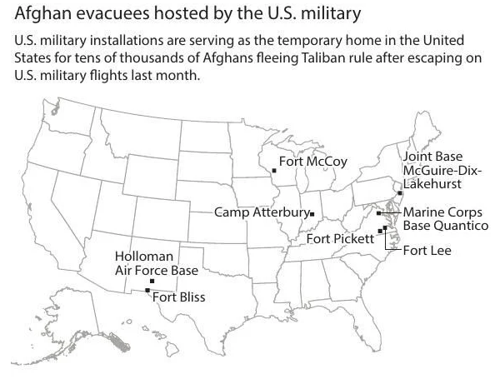
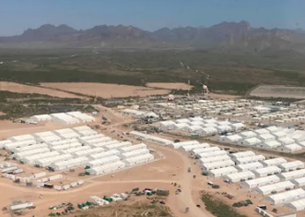
Afghan Evacuees
A aerial view of part of Fort Bliss Army base in Texas -Sept. 10, 2021.
Source: The Denver Post
Notes:
A aerial view of an area of Fort Bliss Army base in Texas is seen Friday, Sept. 10, 2021. The Biden administration provided the first public look inside the U.S. military base where Afghans airlifted out of Afghanistan are screened, amid questions about how the government is caring for the refugees and vetting them.
Nearly 10,000 Afghan evacuees are staying at the base while they undergo medical and security checks before being resettled in the United States.
The U.S. government spent two weeks building what it calls a village to house the Afghans on the base. It is a sprawling area with hundreds of air-conditioned tents used as dormitories and dining halls on scrubby dirt lots, landscape that in some ways resembled parts of the homeland they fled.
Under the program called “Operation Allies Welcome,” some 50,000 Afghans are expected to be admitted to the United States, including translators, drivers and others who helped the U.S. military during the 20-year war and who feared reprisals by the Taliban after they quickly seized power last month.
Nearly 130,000 were airlifted out of Afghanistan in one of the largest mass evacuations in U.S. history. Many of those people are still in transit, undergoing security vetting and screening in other countries, including Germany, Spain, Kuwait and Qatar.
Members of Congress have questioned whether the screening is thorough enough. Many of the Afghans who worked for the U.S. government have undergone years of vetting already before they were hired, and then again to apply for a special immigrant visa for U.S. allies.
After they are released from the base, they will be aided by resettlement agencies in charge of placing the refugees. The agencies give priority to places where the refugees either have family already in the United States or there are Afghan immigrant communities with the resources to help them start a new life in a foreign land.

Slide 13
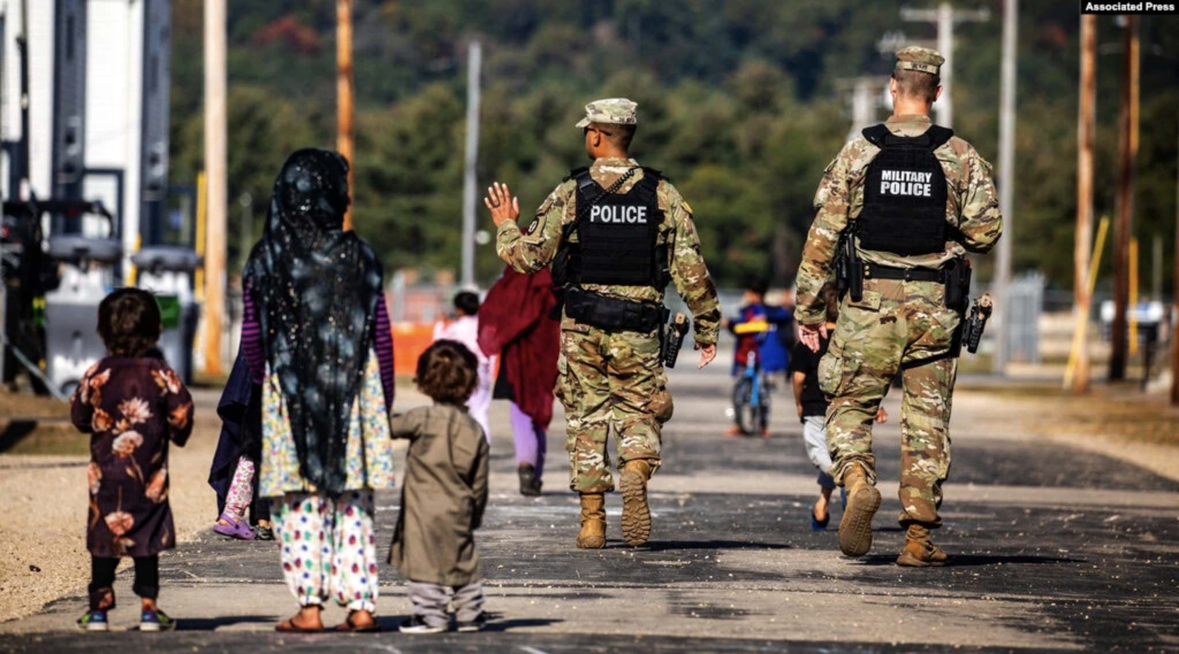
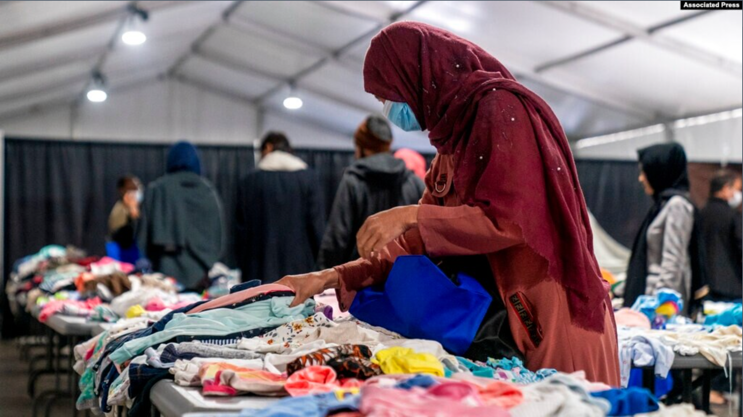
Afghan Evacuees
U.S. Military Police walk past Afghan refugees at the Fort McCoy U.S. Army base, Sept. 30, 2021, in Wisconsin.
Afghan refugees pick out clothes at Joint Base McGuire Dix Lakehurst, N.J., Sept. 27, 2021
Humanitarian Parolees
Notes:
U.S. Military Police walk past Afghan refugees at the Fort McCoy U.S. Army base, Sept. 30, 2021, in Wisconsin. The fort is one of eight military installations that are temporarily housing Afghans who fled after the Taliban took over their country.
Afghan refugees pick out clothes at an Afghan refugee camp at Joint Base McGuire Dix Lakehurst, N.J., Sept. 27, 2021. The camp currently holds approximately 9,400 Afghan refugees and has a capacity to hold up to 13,000.
BREAK

Slide 14
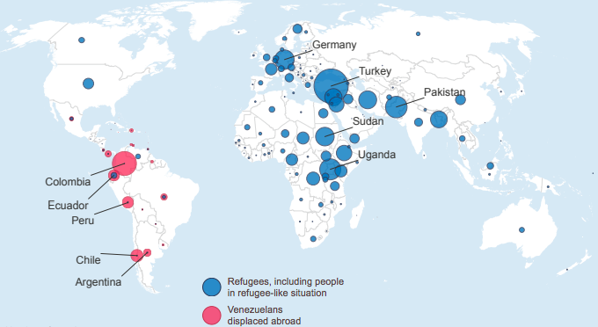
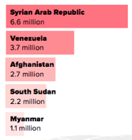
The Global Crisis
1 in 95 people is now forcibly displaced. This compares with 1 in 159 in 2010.
Source: UNHCR
Notes:
NOTE: Ask in chat how many people are forcibly displaced worldwide.
-The United Nations estimated there were 82.4 million people displaced worldwide at the end of 2020 – 26.4 million refugees. 45.7 million internally displaced people. Unprecedented mass displacement. (Click to go to therefugeeproject.org)
68% of all refugees and Venezualans displaced come from just 5 countries: Syria, Venezuela, Afghanistan, South Sudan, Myanmar.
5.6 million registered refugees from Syria - Colorado’s population is 5.7 million.
Turkey is currently hosting more refugees than any other country in the world, with over 3.5 million refugees,
Developing countries hosted 85% of the world’s refugees. The least developed countries provided asylum to a growing proportion, with 27 percent of the global total. These countries are facing severe structural impediments to sustainable development in addition to the challenges of large refugee flows.
UPDATE INFO BELOW:
Overall, the refugee population under UNHCR’s mandate increased by some 65 per cent over the past five years.
REFUGEES include individuals recognized under the 1951 Convention relating to the Status of Refugees, its 1967 Protocol, the 1969 Organization of African Unity (OAU) Convention Governing the Specific Aspects of Refugee Problems in Africa, the refugee definition contained in the 1984 Cartagena Declaration on Refugees as incorporated into national laws, those recognized in accordance with the UNHCR Statute, individuals granted complementary forms of protection, and those enjoying temporary protection. The refugee population also includes people in refugee-like situations.
PEOPLE IN REFUGEE-LIKE SITUATION refers to a category which is descriptive in nature and includes groups of people who are outside their country or territory of origin and who face protection risks similar to those of refugees, but for whom refugee status has, for practical or other reasons, not been ascertained.
ASYLUM-SEEKERS (with pending cases) are individuals who have sought international protection and whose claims for refugee status have not yet been determined. Those covered in this report refer to claimants whose individual applications were pending at the end of 2019, irrespective of when those claims may have been lodged.
VENEZUELANS DISPLACED ABROAD refers to persons of Venezuelan origin who are likely to be in need of international protection under the criteria contained in the Cartagena Declaration, but who have not applied for asylum in the country in which they are present. Regardless of status, Venezuelans displaced abroad require protection against forced returns, and access to basic services. UNHCR and the International Organization for Migration work together with this population by leading the Regional InterAgency Coordination Platform, which is aimed at strengthening the protection dimensions and consistent responses across the region in line with human rights standards.
INTERNALLY DISPLACED PERSONS (IDPs) are persons or groups of persons who have been forced or obliged to flee or to leave their homes or places of habitual residence, in particular as a result of, or in order to avoid the effects of armed conflict, situations of generalized violence, violations of human rights or natural or humanmade disasters, and who have not crossed an internationally recognized State border. For the purposes of UNHCR’s statistics, this population includes only conflict-generated IDPs to whom the Office extends protection and/or assistance. The IDP population also includes people in an IDP-like situation.
PEOPLE IN AN IDP-LIKE SITUATION refers to a category which is descriptive in nature and includes groups of people who are inside their country of nationality or habitual residence and who face protection risks similar to those of IDPs but who, for practical or other reasons, could not be reported as such.

Slide 15
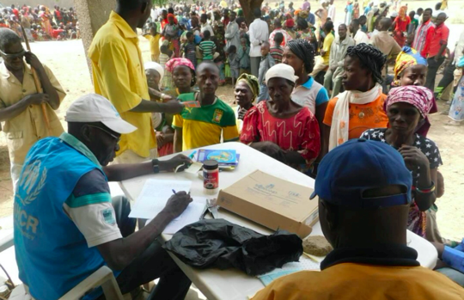
Refugee Protection
Leads and coordinates international action for the worldwide protection of refugees and resolution of refugee problems
Sources: 1951 Refugee Convention
UNHCR
Notes:
The UNHCR is the organization responsible for evaluating a person’s claim to refugee status against these criteria. In the United States, the term “refugee” is used to refer to someone who was given that status overseas by the UNHCR
The United Nations was created following WWII in the hope that a strong international organization could prevent global conflicts in the future. Ethnic cleansing and fear of genocide uprooted over 11 million people from their homes over the course of WWII.
The United Nations High Commissioner for Refugees (UNHCR) was created to save lives and protect the rights of refugees and displaced people.
Read slide.

Slide 16
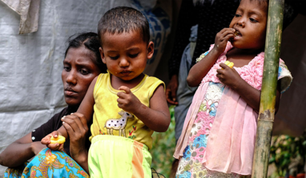
Refugee Protection
Upholding the fundamental human rights of refugees
Ensuring access to vital services
Ensuring that refugees are not forcibly returned to the place from which they’ve fled
Sources: 1951 Refugee Convention
UNHCR

Slide 17
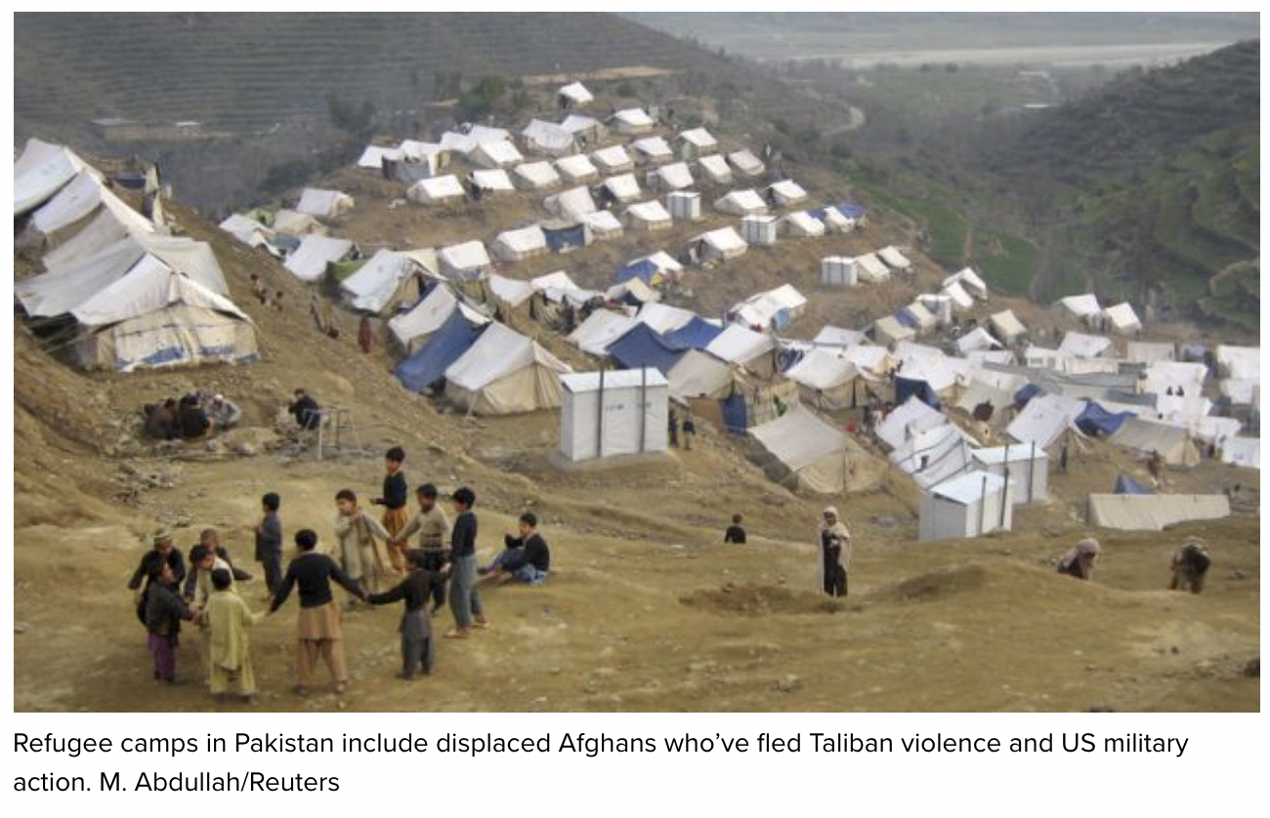
Host Country Living
UNHCR Camps
Notes:
In rural areas, many refugees live in camps.
The biggest refugee settlement in the world is near Cox’s Bazaar in Bangladesh, where 700,000 Rohingya refugees live in 26 camps.
This photo shown here is of a camp for Afghan refugees in Pakistan.
Many countries facing an influx of refugees have established refugee camps to provide temporary housing. Lacking a solution for the refugee crisis, these temporary facilities become long-term housing for many refugees. As a result, many refugees spend years or even decades in refugee camps. The refugees often are legally prohibited from obtaining employment. They must rely on aid from the United Nations and other organizations for their survival.
This study considers some of the impacts of living in a refugee camp and surviving solely on humanitarian aid. In particular, this study examines the structural dependency observed in the Sudanese refugee women in the Kakuma Refugee Camp in Kenya.”
Gladden, Jessica (2020) "System of Structural Dependency in the Sudanese Refugee Women of Kakuma Refugee Camp, Kenya," The Journal of Sociology & Social Welfare: Vol. 47 : Iss. 1, Article 8.

Slide 18
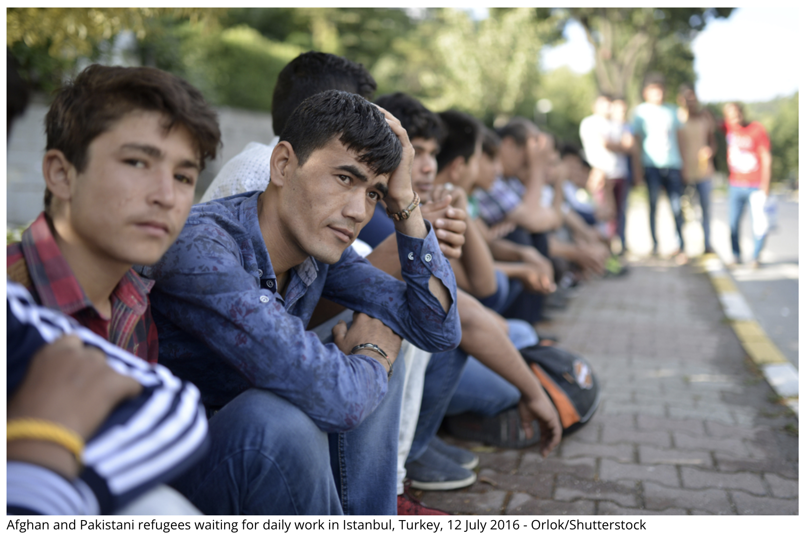
Host Country Living
Urban Refugees
Notes:
It’s very much a misconception that refugees live in camps only. Actually, 60%+ live in cities (UNHCR). Refugees in both scenarios face a number of risks. Urban refugees may be vulnerable to exploitation, arrest or detention, and are often forced to compete with the poorest local workers for the worst jobs. The vast majority of refugees are not legally allowed to work in their host country. Crowded conditions and a lack of resources in camps present a number of safety and health concerns.
This photo is in Istanbul, Turkey. Of the 3.5 million refugees being hosted in Turkey, about 130,000 are from Afghanistan. Afghans represent Turkey's largest community of irregular migrants, still growing despite forced repatriations, denied rights, and difficult living conditions
This spot is where Afghan migrants seek daily jobs every morning. Job hunting begins before dawn: if they are lucky enough, a car will arrive to pick them up. If not, tomorrow morning they will be back, because daily job hunting never ends.
One of the men interviewed works at construction sites 12 hours a day and getting paid 70 Turkish liras (11 Euros) for a work day.

Slide 19
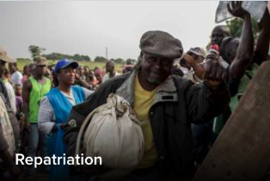
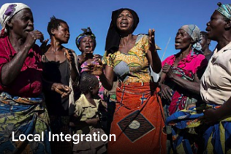
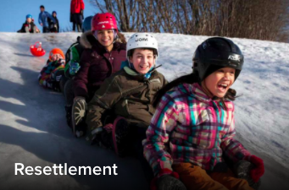
Durable Solutions
UNHCR’s Ultimate Goal: Find solutions that allow refugees to rebuild their lives
Less than ½ of 1% of the world’s refugees are resettled.
Top Resettlement Countries Include:
Canada
United States
Australia
Nordic Countries
Notes:
A frequently quoted statistic is that the average amt of time a refugee spends in exile is 17 years. We don’t actually have an accurate statistic. What we do know is that over half of all refugees have been in exile for over 5 years, and 2/3 of those have been in exile for over 10 years (all the way up to 55 years in a few very protracted situations, such as Western Sahara. (http://blogs.worldbank.org/dev4peace/how-many-years-do-refugees-stay-exile)
The ultimate goal of the UNHCR is to find solutions that allow refugees to rebuild their lives.
CLICK
1. Voluntary Repatriation to the home country is the best solution as soon as it is safe to do so.
Millions of refugees dream of going home. As the durable solution of choice for the largest number of refugees, voluntary repatriation in safety and dignity requires the full commitment of the country of origin to help reintegrate its own people. It also needs the continuing support of the international community through the crucial post-conflict phase to ensure that those who make the brave decision to go home can rebuild their lives in a stable environment.
CLICK
2. Integration into the host country is the next-best option as social and cultural conditions may be similar to the home country. Millions of refugees around the world live year after year with little hope of ever returning home. Some cannot because their countries are engulfed by endless conflict or because they fear persecution if they were to return. Legal local integration requires that the host country offer permanent residence and legal employment options to the refugee.
CLICK
3. The third option is resettlement. In the refugee status determination process, the UNHCR identifies the most vulnerable refugees. Vulnerability categories include victims of torture, women and children on their own, and people with pressing medical concerns that are unable to be addressed in the host country. These are the refugees who are referred for resettlement. Resettlement is the transfer of refugees from a host country to another State that has agreed to admit them and ultimately grant them permanent settlement. Approximately 8 percent of refugees are referred for resettlement, but less than one half of 1% worldwide are ever resettled in a third country.
CLICK
There are approximately 30 countries who offer resettlement to refugees, the top ones being Canada, the U.S., Australia, the Nordic countries, and other Western European countries.

Slide 20
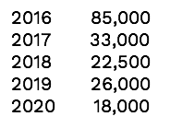
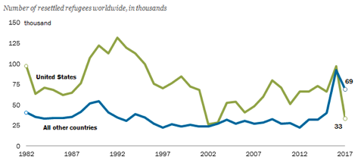
Resettlement
2021 62,500
2022 125,000
The U.S. has been resettling refugees since WWII and a resettlement program became part of U.S. law in 1980.
Notes:
The US has been resettling refugees since WWII, and a resettlement program became part of US law in 1980. Between 1980 and 2017, the U.S. was the top resettlement country in the world, resettling approximately 75,000 people a year for a total of over 3 million people.
The green line in the graph shows the number of refugees resettled in the US each year, contrasted against the blue line, which is the numbers of refugees resettled by all other resettlement countries combined. As you can see, our role in resettlement shifted dramatically in 2017, when for the first time, the number of folks resettled by us dropped sharply below all other countries.
In 2018, Canada became the top resettlement country in the world.
CLICK: The amount of refugees allowed into our country in any given year is set by presidential determination, meaning that the president and their administration has total authority on the matter. In 2016 the administration set the quota at 85,000 refugees and that’s how many we brought in. The first year of the Trump administration represented the smallest number of refugees admitted into this country since WWII. And the numbers have been set lower each year.
CLICK: The amount of refugees allowed into our country in any given year is set by presidential determination, meaning that the president and their administration has total authority on the matter. In 2016 the administration set the quota at 85,000 refugees and that’s how many we brought in. The first year of the Trump administration represented the smallest number of refugees admitted into this country since WWII. And the numbers have been set lower each year.
In 2020, the administration set a ceiling of only 18,000 refugees. And that was pre-pandemic. Refugee admissions to the US were halted between March and June. Last year less than 12,000 refugees have found new homes here.
CLICK
Thank goodness the tides have changed and there is renewed administrative support for the US resettlement program. The pres. determination for this year under the Biden administration was set at 62,500 refugees, with a promise to increase that to 125,000 people next year.
This presents an amazng opportunity that comes along with daunting challenges. In 2016, our office resettled about 600 refugees with over 50 staff members. Last year, we resettled only about 100 people with about 20 staff members. This provides you with a microcosm glimpse of what has happened to all refugee processing and services associated with the US resettlement program - staffing and therefore capacity has been decimated over the last 4 years.
The challenge of attempting to resettle larger numbers of refugees than ever before NEXT YEAR while we are still just beginning to rebuild capacity is where you come in.
In Feb Biden signed an Executive Order to Rebuild and Enhance programs to resettle refugees. “ To meet the challenges of restoring and expanding USRAP, the United States must innovate, including by effectively employing technology and capitalizing on community and private sponsorship of refugees, while continuing to partner with resettlement agencies for reception and placement.”
We’ll talk more about what that looks like momentarily.

Slide 21
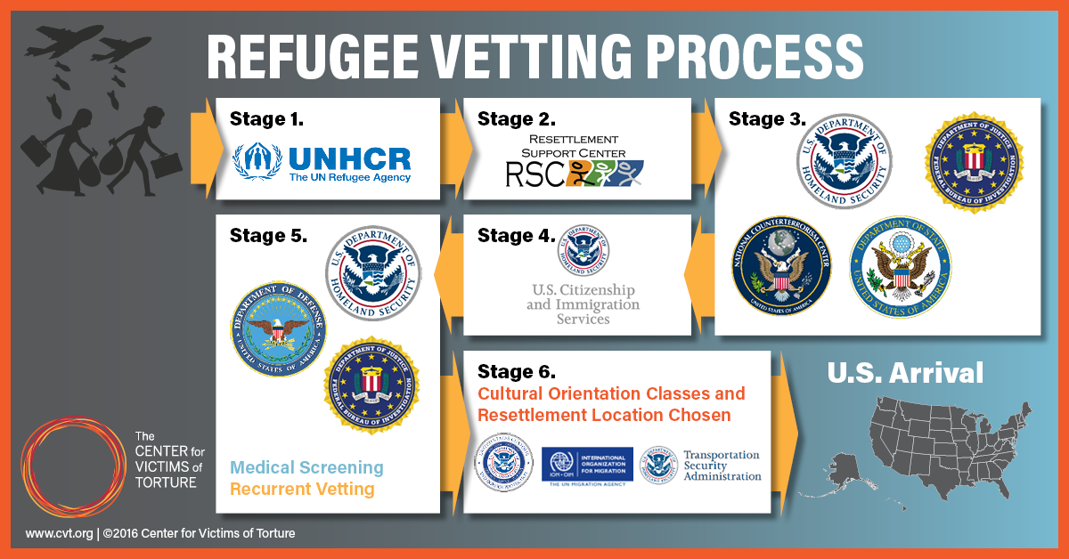
The U.S. Process
Notes:
In fact, of the 3 million refugees resettled in our country, not a single one has committed a fatal act of terrorism.
This is partly due to the fact that refugees are the most thoroughly vetted population that is allowed entry into our country.
Min 2 year process, often much longer
In the refugee status determination process, the UNHCR identifies the most vulnerable refugees. Vulnerability categories include victims of torture, women and children on their own, and people with pressing medical concerns that are unable to be addressed in the host country. These are the refugees who are referred for resettlement. Refugees who are referred to the U.S. resettlement program first undergo extensive screening by:
The National Counterterrorism Center
Department of Homeland Security
The US Department of State Federal Bureau of Investigation
Then US Citizenship and Immigration Services.
At that point they undergo a thorough medical screening and recurrent vetting, with additional screening by the Dept of Defense.
Once they are accepted for resettlement in the US, a location is chosen and the refugee attends cultural orientation classes to prepare them for their new home.
The International Organization for Migration (an agency of the UN) buys the plane tickets for the refugee to get to the US. The cost of the tickets is an interest-free lloan to the refugee, who has to start repaying it 6 months after arrival.
The U.S. Refugee Admissions Program (USRAP) is managed by PRM (The Bureau of Population, Refugees, and Migration (PRM) is the humanitarian bureau of the State Department.) in cooperation with the Department of Homeland Security (DHS) U.S. Citizenship and Immigration Services (USCIS), and the Department of Health and Human Services (HHS) Office of Refugee Resettlement (ORR).
When UNHCR — or, occasionally, a U.S. Embassy or a specially trained nongovernmental organization — refers a refugee applicant to the United States for resettlement, the case is first received and processed by a Resettlement Support Center (RSC). The U.S. Department of State’s Bureau of Population, Refugees and Migration (PRM) funds and manages nine RSCs around the world, operated by international and nongovernmental organizations and one U.S. interests section. Under PRM’s guidance, the RSCs prepare eligible refugee applications for U.S. resettlement consideration.
Some refugees can start the application process with the RSC without a referral from UNHCR or other entity. This includes close relatives of asylees and refugees already in the United States and refugees who belong to

Slide 22
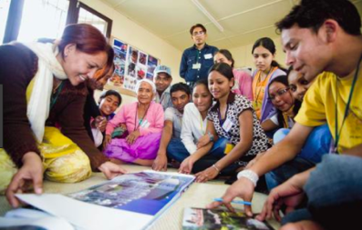
Pre-Departure
Cultural Orientation class
Travel arrangements
Plane ticket (loan)
Notes:
Once they are accepted for resettlement in the US, a location is chosen and the refugee attends cultural orientation classes to prepare them for their new home.
The International Organization for Migration (an agency of the UN) buys the plane tickets for the refugee to get to the US. The cost of the tickets is an interest-free loan to the refugee, who has to start repaying it 6 months after arrival.

Slide 23
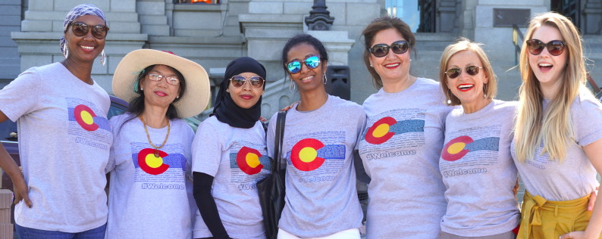
Who is ACC?
To be an integrative center of multicultural exchange where community members feel a sense of belonging and actively contribute to an inclusive society.
Refugee Resettlement Agency, est 2001
To help refugees and immigrants rebuild safe, sustainable lives in Denver.
Notes:
Before a refugee even arrives in the States, they are assigned to a refugee resettlement agency in their destination city. ACC is one of three resettlement agencies in Denver. We were established in 2001 with just 3 staff resettling 60 Sudanese refugees. Currently we have about 30 staff assisting approximately 1500 refugees a year. Over half of our staff are immigrants or refugees themselves. Despite what this photo shows, about half of our staff are also men! ;)
Our mission is to help refugees and immigrants rebuild safe, sustainable lives in Denver.
Our vision is to be an integrative center of multicultural exchange where community members feel a sense of belonging and actively contribute to an inclusive society.

Slide 24
ACC’s Services
Notes:
Start at 0:52
Pass out worksheets during

Slide 25
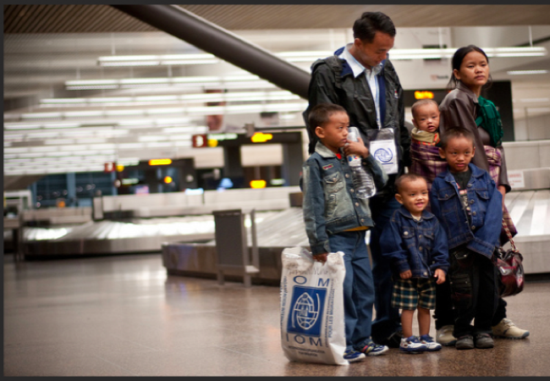
Reception & Placement (R&P)
Notes:
Going to discuss our different needs in the context of our programs – please jot down opportunities that fit with your schedule, availability and interests
Housing
Usually find out about a month in advance when a family is schedule to arrive
Find a place for them to live and get it furnished
Stock with basic ethnic groceries and a warm meal on the day of arrival
Case Management Team picks up from airport and introduces them to their new home
Public Assistance
Case Managers complete and submit pubic assistance paperwork. Refugees are eligible for the same public assistance as citizens – social security, Medicaid, food stamps, bus passes. There are also cash assistance programs that support refugees as they seek employment.
A unique benefit for refugees is that they receive 5 years of free English language classes. CMs get each new arrival set up with an intake appointment for classes at Emily Griffith Technical College.
School
We have a School Family Liaison who gets all children are enrolled in school and helps advocate on behalf of the family within the school system if difficulties arise (inadequate language services, bullying, etc).
Health
Refugees are required to attend 2 health appts within the first 90 days of arrival – both a physical and a mental health examination. Our Health Coordinator schedules the appointments, arranges transportation for families, and assists with billing and follow-up. Any issues that need to be addressed are referred out (no therapeutic or clinical services on site)
Community Orientation
12 hour class for new arrivals outlining the resettlement process and providing a ”Denver 101” – information about rights/responsibilities/laws, public transportation, shopping, etc.

Slide 26
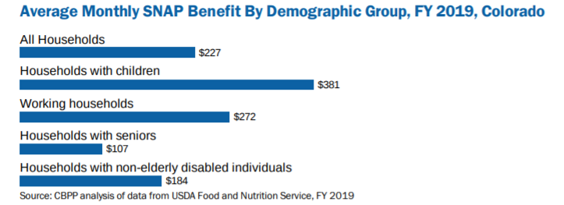
SNAP Benefits (food stamps)
EBT benefits are loaded onto the card once per month (between the 1st and 10th of the month).
Notes:
The Supplemental Nutrition Assistance Program (SNAP) helps low-income households in Colorado purchase food. It provides a monthly benefit that helps families and individuals buy the food they need for good health.
The benefit is provided based on income, resources and the number of individuals in the household. Electronic Benefit Transfer (EBT) cards are used to receive the benefit and can be used similar to debit cards at participating food stores. The benefit can be doubled in value by shopping at participating markets and food stores that support the Double Up Food Bucks program.
SNAP is part of a federal nutrition program to help low-income households purchase food. County human services departments are responsible for determining eligibility and authorizing SNAP.

Slide 27
On-Going Services
Services Staff
Referrals and coaching offered as needed by Health and Education Coordinator, Community Engagement Coordinator, and Integration Programs.
Integration Coach
R&P Services; Create a career plan for each individual and make referrals to needed training & educational programs
Community Member (Wellbeing Inventory)
Economic Empowerment Coach
Develop employment plan and guide initial job placement. They may also work with community members to resolve issues with public benefits and ensure follow-up (especially with families enrolled in TANF- Temporary Assistance for Needy Families)
Notes:
The WIP is the tool used to gauge and understand a family’s wellbeing. The WIP provides the Coach with feedback regarding a snapshot of the families they serve, changes in knowledge, behavior, and circumstances, and opportunities to set goals to increase a family’s integration and wellbeing. The Coach will use the WIP to activate resources, internal and external, that support family wellbeing. Contractor performance will not be based upon the CFSA scores or clients’ responses to the Integration Self-Assessment. CRSP expects individualized and meaningful Action Plans that are built upon the information gathered from the Wellbeing Inventory

Slide 28
Partnering with Refugees-
5 Volunteer Frameworks
Recognize your privilege and power
Use a strengths-based approach
Set healthy boundaries
Be trauma-informed
Practice cultural humility
Notes:
See comment!

Slide 29
#1: Recognize Your Privilege and Power
In relationship with a refugee, a volunteer will hold an immense amount of power based on the identities that they hold in U.S. society.
This power imbalance can cause discomfort, and if we’re not careful, can lead to saviorism.
“I hold so much privilege -shouldn’t I do as much as I can to fix their problems/ make their life easier?”
Notes:
As workers in ref resettlement, I was born and raised here, privileges of citizenship, have had home and access to food, benefits of white privilege. Case for many volunteers, too. I’m going to be working with people who have experienced types of hardship I’ve never had to deal with. This is very uncomfortable. This discomfort makes us very susceptible to the adoption impulse. The --- is coming from a place of privilege - I have more I can help you. Can cause an orientation of pity. Not helpful or empowering. The desire to rescue refugees from the poverty they are going to have to experience when they come here - because federal funding for refugees is slim and public benefits are only barely enough to get by. The desire to rescue from financial hardship - people want to throw money. Very problematic. Keep in mind, not all good impulses are beneficial. Refugees I knwo are more resourceful and resilient than I am probably because I haven’t had to navigate the hardships they have had to. If I focus on needs, I miss the opportunity to learn from their strengths. It’s hard to watch a refugee struggle - not to rescue or pity them, - job to help them access resources, which wont’ look like yours. Coming here a refugee will likely encounter the highest cost of living they’ve every experienced, and it may be much higher than they even expected. They might have heard from their cousins who went to somehwere in the midwest whose rent is $500 versus $1200. So it’s a huge shock when they come to CO and see how expensive things are here. And it’s true, refugees come from a variety of backgrounds, may have been well off in home country and may be well educated. This can bring own challenges to living below poverty line.
• For most refugee families, being resettled in the US can be a jarring experience because of how much things cost, especially rent. Most refugees will experience low-income levels for the foreseeable future, such that shows of largesse by some groups stand to complicate the family’s adjustment to their new lives over the long term.
• It is important to be mindful that income inequality is higher in Connecticut than in any other state, and that the contrast between the communities you come from and the communities in which you are resettling is likely to be stark.
• Orienting the family to stores where they can afford to shop using public transportation is critical.
• Buying expensive electronics and installing cable television is not recommended given the family’s tight budget.
• Understanding that banking, work, and specialty food shopping (e.g., halal) can be very different and complicated for many refugee families. For example, those coming from primarily cash economies may not be ready to manage a checking account, Similarly, a construction job in the US may require facility in sophisticated tools that may be totally different from how it’s done in the home country. Shopping for halal meat on a SNAP budget may not be practical for some refugee families.

Slide 30
#2: Use a Strengths- Based Approach
Strengths- Based Approach
A positive psychology perspective that emphasizes the capabilities and strengths of the individual.
Approaches the work with the knowledge that refugees are resilient, hard-working, motivated, and capable of great success.
Building upon strengths
Empowerment
Self- Sufficiency

Slide 31
#3: Set Healthy Boundaries
Prior to starting your volunteer role, make sure you are ready to maintain clear boundaries.
be realistic about commitment
stick to role
Time Commitment
Time of day
Transporting refugees in your car
Notes:
We encourage volunteers to socialize with our community, help them feel welcome, learn about their culture, etc. The bottom line to remember is to stick to the parameters of the task you were assigned
-- social security office scenario,
Invited in
Asked to help with groceries
Ultimate goal of resettlement is self-sufficiency – you don’t want to do anything that is going to impede that

Slide 32
Let’s Practice- Setting Boundaries
Ex | What does this sound like?
Time Commitment | “I’m really excited to work with you! Just so you know, I am available to meet-up once per week. I am working a full-time job and I also have my family at home.”
Time of Day | “I have set aside Thursday evenings for our meetings- does it work for you to meet every Thursday at 6p.m.?
Transportation | “I’m not comfortable driving other people in my car, but I can help you look up a bus route on Google Maps.”
Answering phone calls or texts | “Since I work full-time from 9-5 on weekdays, I may not be able to answer your calls or messages during the day. I will reply back to you when I can- but if it is something more urgent, you should call ACC.”

Slide 33
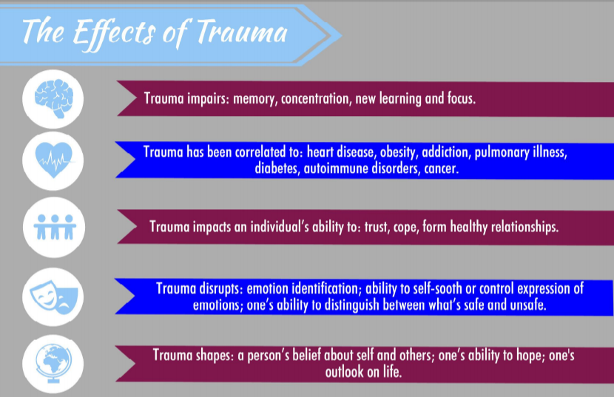
#4: Be Trauma- Informed
Notes:
A Trauma-Informed Care approach strives to understand the whole of an individual who is seeking services. When trauma occurs, it affects an individual's sense of self, their sense of others and their beliefs about the world. These beliefs can directly impact an individual's ability or motivation to connect with and utilize support services.
-the individual needs to know that the provider is trustworthy. Trustworthiness can be evident in the establishment and consistency of boundaries and the clarity of what is expected in regards to tasks.
-the more choice an individual has and the more control they have over their service experience through a collaborative effort with service providers, the more likely the individual will participate in services and the more effective the services may be

Slide 34
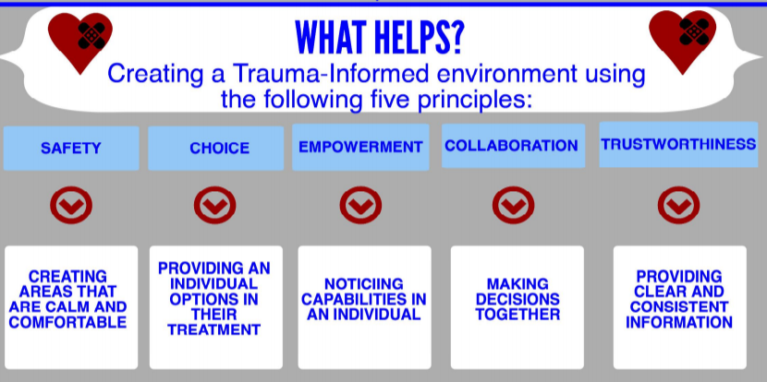
How to create a trauma-informed environment

Slide 35
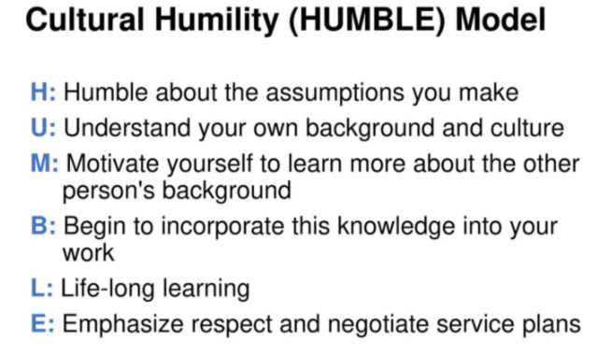
#5: Practice Cultural Humility
Cultural Humility is a term that was first used in the healthcare field and was later adapted for social work and other fields. It encourages personal reflection and growth around culture.

Slide 36
#5: Practice Cultural Humility
Notes:
This image is seen as either a duck, a rabbit, or both.
• Underscoring that there are often different ways of viewing something or a situation, it is useful when trying to gain perspective on or understand something to ask oneself “How could I be wrong?”
• This question is a useful in checking one’s frustration in dealing with an unfamiliar perspective without judgement.
When you’re saying to yourself - why are they not understanding me? What am I doing wrong? Recognize that it may not be you are wrong, but rather you are coming from a totally different perspective. Give yourself balance.
The simple point that can be learned from this famous example of perceptual ambiguity is that we all understand things from our own point of view. The events of our past have formed a lens or paradigm through which we see the world. And since no one’s past is exactly like anyone else’s, no two people will see everything alike.

Slide 37
Let’s say…
You arrive at your new friends’ home and see that their 3 year old is out front of the apartment building with a few other kids who are maybe 7 or younger, and no adult. One day your friend tells you she fell asleep at the same time her 3 year old did, but she awoke to a knock on the door and the maintenance man had brought her daughter back because he found her wandering around the parking lot. What do you do?
Photo Courtesy of Church World Service
Scenario Courtesy of LFSRM
Notes:
Possible responses
Need to educate family in non-condescending way
Maybe she is coming from a place where there is more community support and she doesn’t realize the dangers - explain
When having gentle conversations with her keep in mind she is not intentionally putting kids in danger
Build bridges with other folks in neighborhood - perhaps parents can swap child care
Suggest she invite a female friend over who can support her
Seems like a pattern is emerging - why? Is mom sick? Has she been to a doctor?
Help them install a deadbolt
I appreciate that nobody said these are terrible parents, and that you recognized they are likely coming from a place with different expectations. Where you do send your kids out into the community and everyone keeps an eye on them. AND that you also said you can’t just ignore the safety concerns this situation presents. You all talked to mom and addressed it.
Asking questions is always a good place to start.
Is everything ok with mom?
Never make assumptions.
Ask questions.
While we want you to approach things with a cultural humility lens, we also don’t want you to ignore a concern that is health or safety related. As volunteers with ACC, you are mandatory reporters alongside us. What this means is that if you witness child abuse or neglect, we ask that you report that to us so that we can support you in reporting the behavior to the Dept of Human Services. Because we are viewing this situation holistically and through the lens of cultural humility, we know that this situation doesn’t rise to the level of a reportable offense. However, that doesn’t mean that come else wouldn’t.
In most cases we ask that you really take ownership and troubleshoot the situation on your own. If you have real health and safety concerns that you worry are not being understood by your friends, please invite us in. We can send a staff member with an interpreter to have the conversation alongside you.
As you can see with this, there are no right answers. BUT, there is a right approach, which is to try to avoid jumping to conclusions and to ask a lot of questions.

Slide 38
Let’s say…
You discover huge issues with your family’s apartment management. Apparently they have ignored multiple requests to fix plumbing and heating. What steps could you take and what would be the pros and cons of those steps? You are sure you could find them a better housing situation, which would also mean they’d need to break their lease. What are the pros and cons of that?
Notes:
Possible responses
Witness with family and help them document
If necessary could escalate things - code violations
Up & lvg could have significant impacts
Landlord is in violation of CO law, could find a pro bono lawyer to represent family
Model how to handle for the family
I commend ___ group for asking the question: How was this documented? Did they tell the guy cutting the lawn or fixing the fence? OR Did they go online and submit a request form? It is quite possible the landlord actually has no idea .
Remember; The correct answer for all of these scenarios is to ask questions.
What is the problem with the housing? How are you using the ____?
When did you say something?
Who to?
Remember that our goal is to help our friends get sulf-sufficient and then work towards their highest aspirations. We want to work ourselves out of a job, and you want to not be needed.
Help them learn to do on their own. Go with them to find out the process to report a problem with their apt. Walk with them to the leasing office. Start there and ask questions. Understand bigger picture. Coach on how to submit a request. If that’s not realistic, explain other ways to report issues.
If you are sweeping in and solving it for them, if the problem re-occurs, they don’t know how to address it.
And always, give both parties the benefit of the doubt.
Here’s story for you. There was a Congolese family who told their American friend that their tub wasn’t draining and that they reported it and nothing happened. The friend took photos and went to the manager. Turns out the complex was peeved at the family because they had put a couch outside the apartment which was a code violation, and the family didn’t remove it as requested, so the complex did. A month or so later, the family put another couch outside. It also turned out that the manager had the tub fixed previously, and they found a bunch of pebbles in the drain that the kids had put there. The manager is considering charging the family for the maintenance costs since they are responsible.
Our relationships with landlord are really important. How much does a 2 bdrm in Denver cost?
We are limited by public transportation (try to keep commute to our office and to a potential employment site to less than an hour)
The housing relationships we have we need to cultivate
If the situation is truly awful and all attempts at resolution are unsuccessful, please reach out to us and we can bring in the housing coordination team.
On this note - apartment set up
If the situation is truly awful and all attempts at resolution have failed.

Slide 39
Let’s say…
Your friend Ahmed tells you that ACC isn’t helping him or his wife and 3 kids. He accuses the case manager of stealing his welcome money and tricking him because he doesn’t speak English. He’s angry because his food stamps card stopped working and and Ahmed doesn’t know why. He tells you that his case manager doesn’t call him back and is responsible for the lack of services. What do you do?
Notes:
What’s the first thing you do? ASK QUESTIONS!
What questions do you ask?
Does he know how food stamps work?
Acknowledge how he feels - all of this is overwhelming
What emotions do you think Ahmed is feeling?
Abandoned
Betrayed
Taken advantage of
Afraid
He’s a dad and he needs to take care of his family and put food on the table. His accusations are rooted in love for his family and feeling like the system is not helping him take care of them.
Troubleshooting:
Make sure he has access to food (take to food pantry, ask what cash resources the family has)
EBT (Electronic Benefits Transfer)
When benefits are issued depends on last digit of SS#, if 1 on 1st day of month, 6 on 6th day, etc.
Income dependent - possible he’s over income
Talk about “Welcome Money” - what is it
Why does he think the case manager is stealing his money? Example of where the misunderstanding could be coming from. Ahmed’s cousin Najibullah has 8 kids, and is living in Nebraska in a 4 bedroom house with a yard. At the end of 3 months, his case manager gives him $3000. Najibullah calls Ahmed with excitement.
We have a grievance policy at ACC that all families are told about at intake. Remind them of this. It allows them to advocate for themselves. At the end of the day they’ll feel heard and their needs will get met.
Many of our community members come from countries or cities where they could not trust the government or its affiliates. They may also have heard rumors that resettlement agencies just take their money without actually providing services or helping them. We need your help in encouraging them to trust ACC and our staff members, assuring them that we are doing everything we can to provide resources and use their money most effectively.
Without that trust, not only would they feel uncomfortable in their new community, but it is also harder for us to work together to effectively assess and address their needs.
This is why your support in this area is so important!

Slide 40
Tolerating Messiness
Notes:
As the manual says, refugee resettlement is messy! • Tolerating messiness requires deep breaths, flexibility, and humility.
• Try to think about the messiness you are going to encounter as beautiful, as depicted in this image by Salvador Dali.
• Negotiate cultural differences while trying to manage communications and miscommunications with aplomb and accept that flexibility is often necessary.
• Embrace the mess! Used to work in Type A work environment. Not going to serve you well in this environment. State bureaucracy capricious and frustrating. By tolerating, you’re embracing everything that comes with it. Negotiating misunderstandings frequently. One should not expect a linear progression in the progress of family. Important to be able to take stock in own patience and understanding. Don’t compare it to something you would be doing personally. Eventually you’ll get used to it. Be pleasantly surprised when things aren’t as messing!

Slide 41
Notes:
The Shahadah (The Declaration of Faith) is the first and most important pillar of Islam. It’s the initial submission to Islam and carried out by those reverts to Islam as a commitment and declaration of their faith.
The shahada is a two-part statement that articulates the main beliefs of Islam.
The first part of Shahada states that there is no god but Allah (SWT) which means that no other being has the right to be worshiped and that Allah almighty has neither partner nor son.
The second part of the Shahada witnesses that our beloved prophet Muhammad (PBUH) is the last prophet & messenger sent by Allah (SWT).
In Islam, there are five obligatory daily prayers in which Muslims must perform in certain ways and times. The times for each prayer vary according to the lunar calendar as they range from sunrise to midnight.
During these prayers, Muslims face Mecca, which is the location of the Kaaba, the most sacred site in Islam. Each prayer includes a recitation of Quran, along with different Ruko.
Prior to each prayer, Muslims must perform a washing ritual in which called “Wudu“(Ablution) to ensure purity prior to standing before Allah (SWT).
3. “Zakat” or Alms-giving is the third pillar of Islam and it is mandatory on every Muslim who is financially capable.
A financially capable Muslim must donate a percentage of his/her yearly income or fortune equal to 2.5% every year to the poor and needy.
Zakat generates a sense of devotion and worship to Allah, sympathy with poor, needy, destitute. It also purifies the hearts of both poor and rich, achieves social justice, and creates a cooperative, cohesive, productive society.
4. “Sawm” or Fasting is the fourth pillar of Islam in which Muslims fast during the daylight hours in the holy month of Ramadan, the 9th month of the Islamic calendar.
Fasting during Ramadan involves discipline and abstaining from many things, such as food, drink (including water), medication, any acts of evil, any sexual activity, backbiting, harming oneself or others, smoking, impure thoughts, etc.
5. “Hajj” or Pilgrimage to the Holy Kabah in Mecca is the fifth and last pillar of Islam.
Hajj occurs annually and performed in the holy month of Dhul Hajj, the last month in the Islamic calendar. Hajj rituals are performed from 8th Zul-Ḥijjah to 12th Zul-Ḥijjah in Makah the city of Saudi Arabia.
It’s obligatory to every Muslim who is physically and financially able to afford the cost and difficulty of travel to visit the holy city of Mecca and make the rites of Hajj. Muslim has to perform this duty once in his/her entire life when healthy, an adult, and having enough money to go to Mecca and perform hajj without causing any harm to his/her family or putting them in financial distress.

Slide 42
Partnering with Refugees as a Co-Sponsor
COVID Policies
Masks are required for all ACC-affiliated activities.
New arrivals may not yet be vaccinated, therefore we ask that any volunteers who may come into contact with our community members are fully vaccinated.
Providing transportation in your personal
vehicle & engaging in home visits with community members are encouraged, with caution.

Slide 43
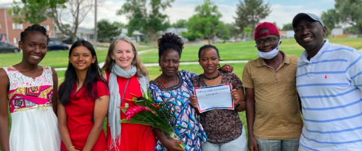
Next Steps
Work on Co-Sponsorship Worksheet
Begin fundraising effort
Submit Application
Background Checks
Attend a Co-Sponsorship Group Training
Get Matched!
Sign Co-Sponsorship MoU
Notes:
Gather information Learn more about what Co-Sponsorship entails by reading through the materials found on ACC’s Co-Sponsorship webpage, particularly the Co-Sponsorship Manual and the Co-Sponsorship Application.
Work on the Co-Sponsorship Application
Begin working on your Co-Sponsorship Application as a way to ensure that you are able to meet all of the requirements of the program.
Attend Initial Trainings All members of your Co-Sponsorship Team (core team members and support volunteers) will need to attend the following 2 preparatory trainings. Each training is offered on a monthly basis (see www.acc-den.org/orientations for the schedule and to sign up). Individuals can sign up to attend trainings as you recruit for your team. Alternatively, if your team is already formed, you can request for us to hold trainings specifically for your group at a time that works for you.
Training 1: General Orientation to learn about who refugees are and how they arrive in the United States, as well ACC’s programs, services, and volunteer policies.
Training 2: Partnering with Refugees at ACC to better understand how to walk alongside a refugee in their integration journey.
Submit Co-Sponsorship Application
Background Checks It is important for each team member 18 years of age and older to submit a background check as part of the application process.
Attend a Co-Sponsorship Training Once your team is set and your Co-Sponsorship Application has been approved, we will organize a team training at our office where we will delve into the nuances of what Co-Sponsorship entails.
Sign Co-Sponsorship Agreement
Arrival and period of committed involvement with refugee family (~ 6 months - 1 year)

Slide 44
THANK YOU!
Website: www.acc-den.org
Facebook: African Community Center of Denver
Instagram: africancommunitycenter
Twitter: @ACCDenRefugees
Email: kate@acc-den.org
Photo: Courtesy of John Abramson
Notes:
END
Any questions?

